Slide 1

Learning Tekken 7
By Zachary Safir

Slide 2
What is Tekken?
A three-dimensional fighting game developed by Bandai Namco Studios
Has a staggering 50-character roster
Each character has over 100 unique moves
Objective is to reduce your opponent's health points down to 0 in a 60 second round
First player to win three rounds wins the match

Slide 3
What Is Reinforcement Learning?
A type of machine learning that trains an agent to act intelligently in an interactive environment
Using trial and error feedback shaped by numerical reward and punishment signals
The goal is to find the correct actions that maximize that numerical value
Continues to learn using past experiences
Different from both supervised and unsupervised learning, a third category

Slide 4
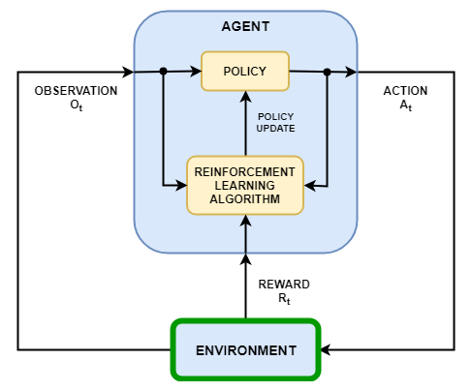
Reinforcement Learning Requirements
Source: https://www.mathworks.com/help/reinforcement-learning/ug/create-matlab-environments-for-reinforcement-learning.html
Reinforcement Learning Process

Slide 5
Key Concept
The curse of dimensionality, the more complex the environment the more difficult it becomes to model
Using deep learning, much of this problem is alleviated
Termed Deep Q-Network
Became able to make very skilled models for Atari video games
Next breakthrough, found that the policy network can also be made into a deep network
A policy gradient actor-critic algorithm called Deep Deterministic Policy Gradients

Slide 6
Self Play and reward shaping
Self play is a multi-agent learning approach that deploys an algorithm against copies of itself
Does not require expert data to teach the model how to act
Reward shaping is the process of adding and applying different kinds of reward signals to the learning agent
In combination with self play, can train agents to handle a variety different play styles

Slide 7
Important Terminology
Frames: A measure of time in a fighting game, each frame is 1/60th of a second, determines how a player can act a given time
Block Stun: Frame count after having an attack blocked
Hit Stun: Frame count after landing an attack
Whiffing: Attempting to attack and missing entirely
Back dashing: A more advanced form of backwards movement
Observation Space: The information pertaining to what an agent can observe at a given time
Action Space: The actions available to the agent

Slide 8
Simplifying the action space
Using prior knowledge, able to simplify the learning process down
Rather than supplying potentially confusing numerical signals, can shape the action space
For example, if the agents frame count is currently negative, remove the ability for it to continue attacking
At the start of the round, prevent the agent from attacking blindly
By considering and accounting for various known situations, can guide the learning process along smoothly

Slide 9
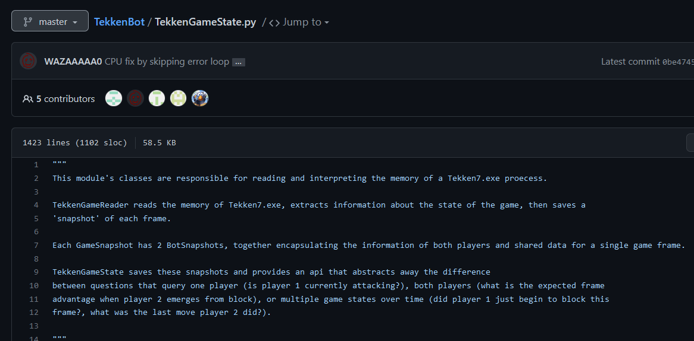
Getting Game values
Source https://github.com/WAZAAAAA0/TekkenBot/blob/master/TekkenGameState.py

Slide 10
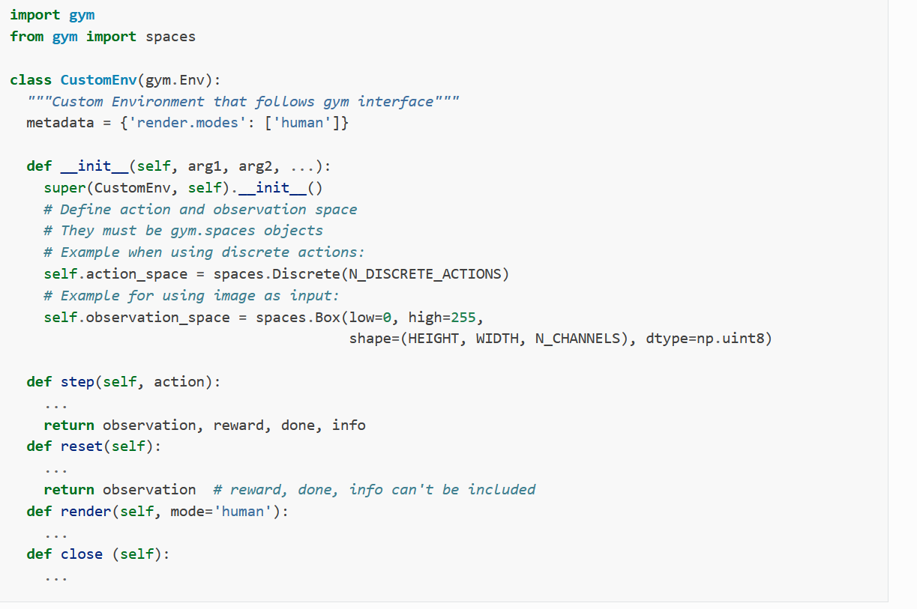
Environment Template

Slide 11
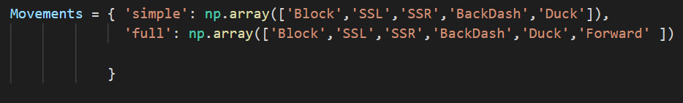

My Action Space

Slide 12
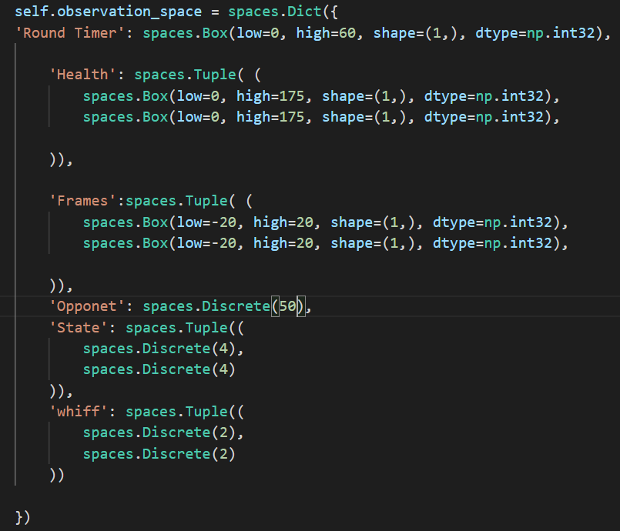
My Observation Space

Slide 13
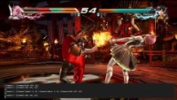
Current State of my Project

Slide 14
What comes Next
Finding and fixing the improperly functioning memory address values
Once everything runs properly, modeling
Finding the best model for playing the game
Devising different learning strategies

Slide 15
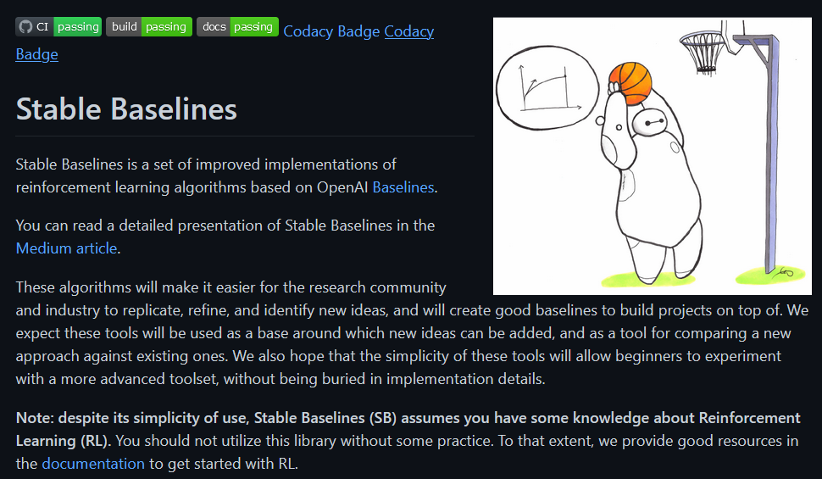
Reinforcement learning Algorithms Ready to use
Source: https://github.com/hill-a/stable-baselines

Slide 16

Thank You

Slide 17
References
Sutton, R. S., & Barto, A. G. (2018). Reinforcement learning: An introduction. MIT press.
MIT Press.Ng, A. Y., Harada, D., and Russell, S. 1999. Policy invariance under reward transformations: Theory and application to reward shaping. In ICML Vol. 99: 278-287
Mnih, V., Kavukcuoglu, K., Silver, D., Rusu, A. A., Veness, J.,Bellemare, M. G., et al. 2015. Human-level control through deep einforcement learning. Nature, 518(7540), 529.
Silver, D., Huang, A., Maddison, C. J., Guez, A., Sifre, L., Van Den Driessche, G., et al. 2016. Mastering the game of Go with deep neural networks and tree search. nature, 529(7587), 484
Oh, I., Rho, S., Moon, S., Son, S., Lee, H., & Chung, J. (2020, January 31). Creating pro-level AI for a real-time fighting game using Deep Reinforcement Learning. arXiv.org.
Yoshida, S., Ishihara, M., Miyazaki, T., Nakagawa, Y., Harada, T.,and Thawonmas, R. 2016. Application of Monte-Carlo tree search in a fighting game AI. In IEEE 5th Global Conference on Consumer Electronics:1-2

